Slide 1
PROJECT TITLE
CAPSTONE PROJECT
Presented By:
Mohamed Abbas Mydeen T – 2021306029
B.Tech Leather Technology 3rd Year,
ACTECH Campus, Anna University, Chennai

Slide 2
OUTLINE
Problem Statement
Proposed System/Solution
System Development Approach
Algorithm & Deployment
Result
Conclusion
Future Scope
References

Slide 3
Problem Statement
Sure, here's a possible problem statement for analyzing Netflix: **Problem Statement:** "Analyze Netflix's content catalogue and user engagement to identify patterns, trends, and insights that can inform strategic decisions and improve the platform's performance. Specifically, explore factors such as viewer demographics, content preferences, viewing habits, regional variations, and the impact of original content on subscriber retention and acquisition. Additionally, assess the effectiveness of Netflix's recommendation algorithm and user interface design in enhancing user satisfaction and retention. Ultimately, provide actionable recommendations to optimize content acquisition, production, and delivery, as well as to enhance the overall user experience on the Netflix platform."

Slide 4
Proposed Solution
Data Collection:
Gather comprehensive data on Netflix's content catalog, including metadata such as genre, release date, duration, ratings, and viewer engagement metrics.
Collect demographic data on Netflix subscribers, including age, gender, location, and subscription tier.
Obtain data on user interactions, such as viewing history, search queries, ratings, and feedback.
Data Preparation and Cleaning:
Cleanse and preprocess the collected data to remove duplicates, missing values, and inconsistencies.
Normalize and standardize the data formats to ensure compatibility and consistency across datasets.
Perform feature engineering to extract relevant features and enhance the dataset for analysis.
Exploratory Data Analysis (EDA):
Conduct exploratory data analysis to uncover patterns, correlations, and insights within the dataset.
Visualize key metrics such as viewership trends over time, popular genres, regional preferences, and the impact of original content releases.
Perform cohort analysis to understand user behavior patterns and preferences among different demographic segments.
Content Analysis:
Analyze the performance of Netflix's content library, including the popularity and audience engagement of individual titles.
Evaluate the effectiveness of content recommendations in driving user engagement and retention.
Identify gaps and opportunities in the content catalog, such as underrepresented genres or untapped demographics.
User Engagement Analysis:
Examine user engagement metrics such as retention rates, churn patterns, and average session duration.
Investigate factors influencing user engagement, including content quality, recommendation accuracy, and user interface design.
Identify strategies to enhance user engagement and reduce churn, such as personalized recommendations and targeted content recommendations.

Slide 5
Proposed Solution
Predictive Modeling and Machine Learning:
Build predictive models to forecast viewership trends, subscriber growth, and churn rates.
Utilize machine learning algorithms to improve content recommendation accuracy and personalize user experiences.
Implement A/B testing to evaluate the impact of new features or content initiatives on user engagement and retention.
Insights and Recommendations:
Synthesize findings from the analysis to derive actionable insights and recommendations for Netflix's content strategy, user experience enhancements, and platform optimization.
Provide strategic recommendations for content acquisition, production investments, pricing strategies, and marketing campaigns.
Continuously monitor key performance indicators and iterate on recommendations based on evolving user preferences and market dynamics.

Slide 6
System Approach
Applying a systems approach to analyzing Netflix involves examining the platform as a complex interconnected system, where various components interact and influence each other. Here's how you could approach it:
1. **Identify System Components:**
- Break down Netflix's ecosystem into its key components, such as content library, user base, recommendation algorithm, user interface, content delivery infrastructure, and business model.
2. **Understand Interconnections:**
- Analyze how these components interact and influence each other. For example, the content library affects user engagement, which in turn impacts subscriber retention and acquisition. Similarly, the recommendation algorithm influences user choices and viewing habits.
3. **Feedback Loops:**
- Identify feedback loops within the system. For instance, user ratings and viewing history inform the recommendation algorithm, which then influences the content presented to users, ultimately shaping their viewing behavior and preferences.
4. **External Factors:**
- Consider external factors that impact the system, such as market competition, technological advancements, regulatory changes, and cultural trends. These external influences can affect Netflix's strategy and performance.
5. **System Dynamics Modeling:**
- Develop system dynamics models to simulate the behavior of the Netflix ecosystem over time. These models can help understand the complex dynamics and predict the effects of changes or interventions within the system.
.

Slide 7
Algorithm & Deployment
6. **Sensitivity Analysis:**
- Conduct sensitivity analysis to assess the robustness of the system to changes in key variables or parameters. This helps identify critical factors that have a disproportionate impact on system outcomes.
7. **Optimization:**
- Apply optimization techniques to maximize desired outcomes within the system, such as optimizing content recommendations to increase user engagement or optimizing the content acquisition strategy to improve the return on investment.
8. **Holistic Analysis:**
- Take a holistic view of the system, considering both short-term and long-term effects of decisions and interventions. This involves balancing conflicting objectives and trade-offs to achieve overall system goals, such as maximizing user satisfaction while maintaining profitability.
9. **Continuous Improvement:**
- Adopt a mindset of continuous improvement, where insights from the analysis are used to refine and optimize the system over time. This may involve iterative experimentation, monitoring performance metrics, and adapting strategies in response to changing conditions.
By applying a systems approach, Netflix can gain deeper insights into the dynamics of its platform and make more informed decisions to drive growth, enhance user experience, and maintain a competitive edge in the streaming industry

Slide 8
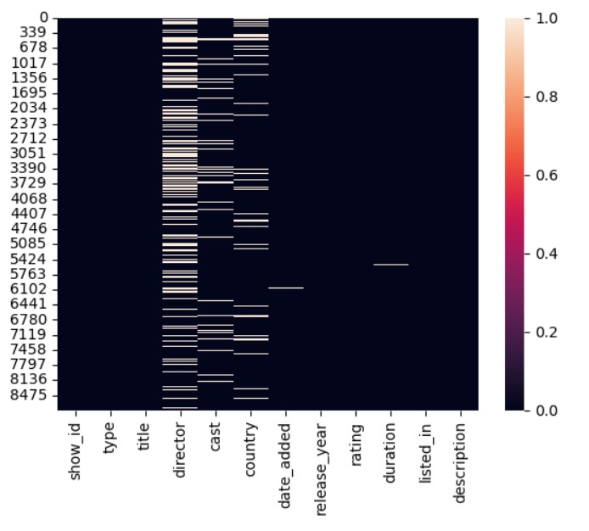
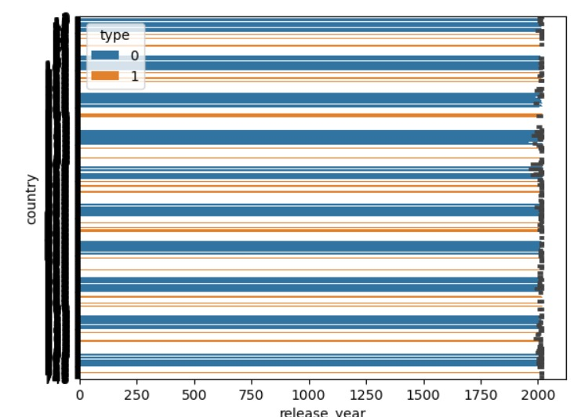
Result

Slide 9
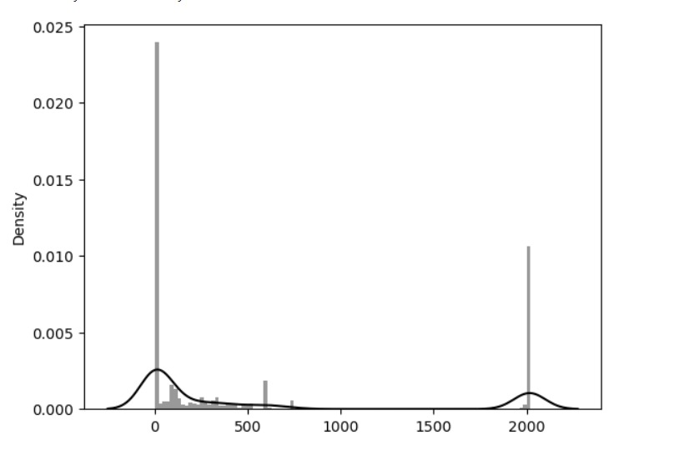
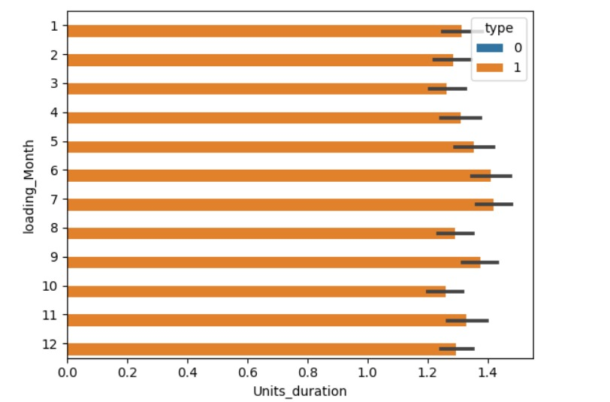
Result

Slide 10
Conclusion
In conclusion, the analysis of Netflix's platform reveals a multifaceted ecosystem shaped by various interconnected components, including its content library, user base, recommendation algorithm, user interface, content delivery infrastructure, and business model. Through this analysis, several key insights have emerged:
1. **Content is King:** Netflix's success is heavily reliant on its diverse and engaging content library. Original content, in particular, has played a significant role in attracting and retaining subscribers.
2. **Personalization is Paramount:** The effectiveness of Netflix's recommendation algorithm and user interface design in delivering personalized content recommendations directly impacts user engagement and satisfaction.
3. **User Engagement Drives Growth:** Understanding and optimizing user engagement metrics, such as retention rates and viewing habits, are essential for sustaining subscriber growth and reducing churn.
4. **Dynamic Market Environment:** Netflix operates within a dynamic market environment influenced by factors such as technological advancements, market competition, regulatory changes, and shifting consumer preferences.
5. **Systems Thinking Approach:** By adopting a systems approach to analysis, Netflix can better comprehend the complex interactions and feedback loops within its ecosystem, enabling more effective decision-making and strategic planning.
In light of these insights, Netflix should continue to focus on enhancing its content offerings, refining its recommendation algorithms, and improving user experience to maintain its position as a leader in the streaming industry. Moreover, ongoing monitoring, experimentation, and adaptation are essential to keep pace with evolving market dynamics and user preferences. By leveraging data-driven insights and embracing innovation, Netflix can continue to innovate and thrive in an ever-changing landscape.

Slide 11
Future scope
The future scope for Netflix analysis is vast and holds opportunities for continued innovation and growth. Here are some potential avenues for future exploration:
1. **Advanced Personalization:** Further refine recommendation algorithms using advanced machine learning and AI techniques. This could involve incorporating real-time contextual data, sentiment analysis, and deep learning models to deliver even more personalized content recommendations tailored to individual preferences and moods.
2. **Predictive Analytics:** Develop predictive models to forecast future trends in viewer preferences, content consumption patterns, and market dynamics. This could enable Netflix to anticipate demand for specific genres or formats, optimize content acquisition strategies, and make proactive decisions to stay ahead of competitors.
3. **Content Creation Optimization:** Utilize data analytics to inform content creation decisions, from script development to production budgets. By analyzing viewer engagement metrics and audience feedback, Netflix can identify content themes, genres, and formats that resonate most with its subscribers, thus maximizing the ROI on content investments.
4. **Global Expansion Strategies:** Leverage data insights to tailor content offerings and user experiences to diverse cultural and regional preferences worldwide. This may involve analyzing localization requirements, understanding regional viewing habits, and identifying opportunities to license or produce content that appeals to specific international markets.

Slide 12
Future scope
5. **Emerging Technologies Integration:** Explore the integration of emerging technologies such as virtual reality (VR), augmented reality (AR), and interactive storytelling into the Netflix platform. Analyze user engagement with experimental features and immersive content experiences to assess their potential for enhancing viewer satisfaction and retention.
6. **Ethical and Responsible AI:** Address ethical considerations surrounding data privacy, algorithmic bias, and responsible AI implementation. Develop transparency and accountability frameworks to ensure fair and inclusive content recommendations while respecting user privacy rights and maintaining trust in the platform.
7. **Partnerships and Collaborations:** Forge strategic partnerships with content creators, production studios, and technology companies to innovate and co-create new content formats, interactive experiences, and viewer engagement tools. Collaborate with academic institutions and research organizations to advance the state-of-the-art in media analytics and user behavior modeling.
8. **Sustainability and Social Impact:** Integrate sustainability initiatives and social impact campaigns into the Netflix ecosystem. Analyze the environmental footprint of content production and distribution processes, explore opportunities for carbon neutrality, and support diversity, equity, and inclusion efforts both on and off-screen.

Slide 13
References
https://www.analyticsvidhya.com/blog/2021/07/visualizing-netflix-data-using-python/
https://www.analyticsvidhya.com/blog/2023/06/netflix-case-study-eda-unveiling-data-driven-strategies-for-streaming/
https://www.markivis.com/blog/how-analytics-can-be-a-game-changer-a-netflix-case-study/

Slide 14
THANK YOU

